Slide 1
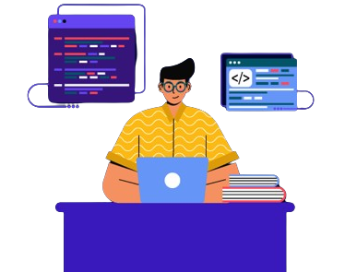
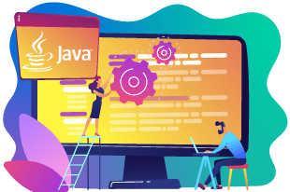
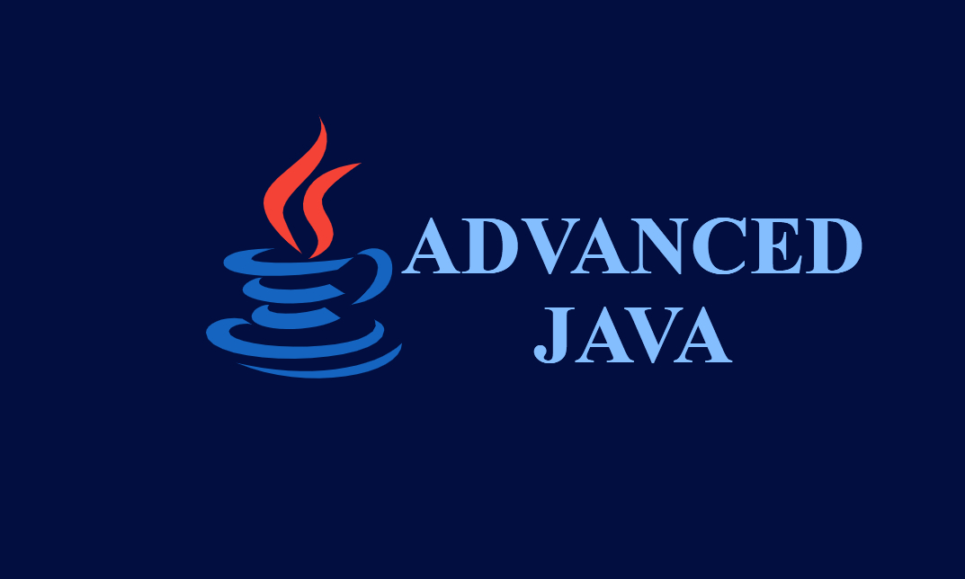


Slide 2
At the end of this lesson you’ll be able to:
Know what is advanced java.
Grasp the overview of Java swing and JDBC.
Crate a form.
Connect To The Database.

Slide 3
Advanced Java plays a crucial role in modern software development by providing a set of powerful tools and technologies that enable developers to build scalable, robust, and feature-rich applications.

Slide 4
"In the vast landscape of technology, mastering Advanced Java is like having a key to unlock the doors of limitless possibilities in software development. Your expertise in Advanced Java isn't just a skill; it's your passport to shaping the future of innovative solutions."

Slide 5
What is java
Java is a widely-used, object-oriented programming language renowned for its platform independence, enabling developers to write code that can run on any device with a Java Virtual Machine (JVM).
Released by Sun Microsystems in 1995, Java is recognized for its versatility, robustness, and scalability.

Slide 6
With a "Write Once, Run Anywhere" philosophy, automatic memory management, and a rich standard library, Java is employed across diverse domains, including web development, mobile applications (especially on Android), and enterprise-level software, supported by a large and active developer community.

Slide 7
What is java swing
Java Swing is a part of Java Foundation Classes that is used to create window-based applications. It is built on top of Abstract windowing Toolkit API and entirely written in java.
The javax.swing package provides classes for java swing API such as Jbutton, Jtexfield, JRadioButton, Jcheckbox, Jmenu, JColorChooser etc.

Slide 8
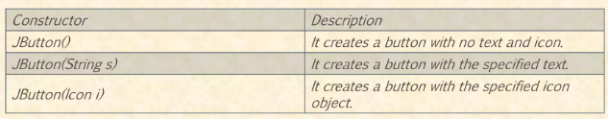
Java JButton
JButton button = new JButton("Click Me“);

Slide 9
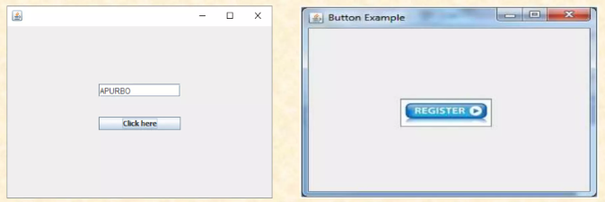

Slide 10
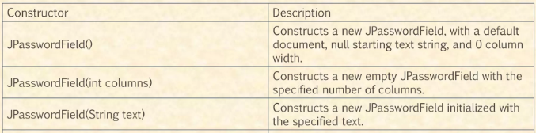
Java JPasswordField
JPasswordField Password = new JPasswordField ();

Slide 11
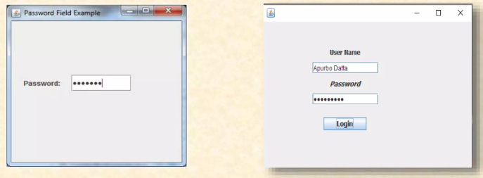

Slide 12
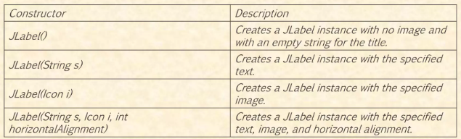
Java JLabel
JLabel Label = new JLabel (“Label“);

Slide 13
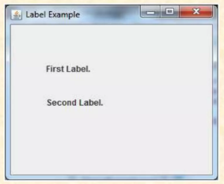

Slide 14
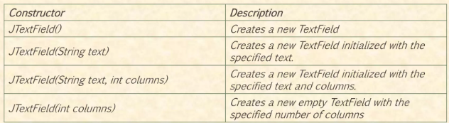
Java JTextField
JTextField Text = new JTextField ()

Slide 15
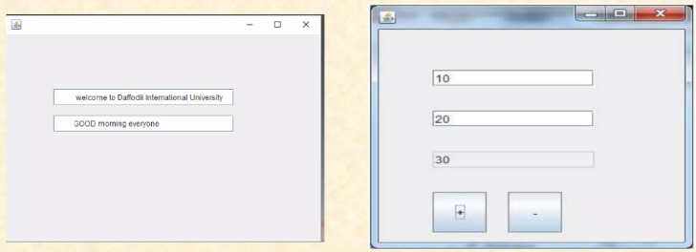

Slide 16
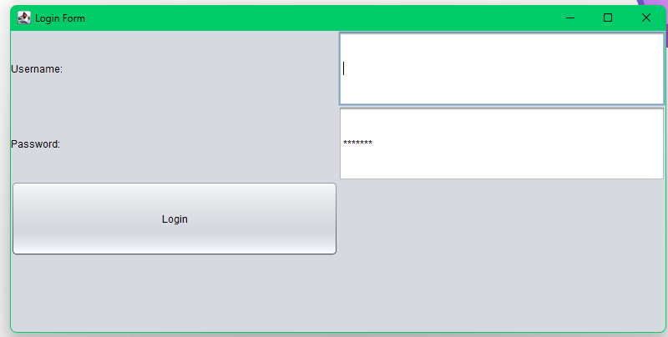

Slide 17
What is JDBC
JDBC is an Application Programming Interface (API) that allows a Java programmer to access any kind of tabular data, such as a database in a Java application.

Slide 18
What is JDBC
JDBC allows the programmer to develop Java applications that can:
Connects to a data source, such as a database
Send queries and update statements to the database
Retrieve and process the results received from the database
JDBC enables programmers to develop data-centric applications that can access and manipulate data from the diverse range of database.
For this, JDBC API consists of the different types of JDBC drivers, as shown in the following figure

Slide 19
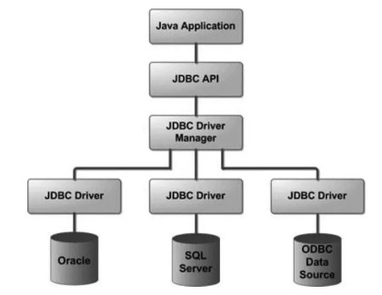
What is JDBC

Slide 20
Types of Drivers
A JDBC driver is a collection of Java classes that enables a programmer to connect a Java application to a certain database.
There are four types of JDBC drivers to connect with the different types of databases. These are:
Type 1: JDBC-ODBC Bridge Driver
Type 2: JDBC-Native API Driver
Type 3: JDBC-Net Pure Java Driver
Type 4: Thin driver

Slide 21
Connecting to database
To connect to a MySQL database in Java, you can use JDBC (Java Database Connectivity), which is a standard Java API for database access.
make sure you have the MySQL JDBC driver. You can download it from the MySQL official website or include it as a dependency in your project if you're using a build tool like Maven or Gradle.

Slide 22
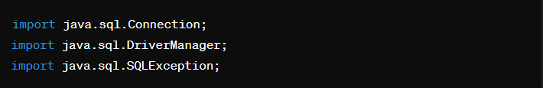
Connecting to database
Import the necessary Java classes for database connectivity:

Slide 23
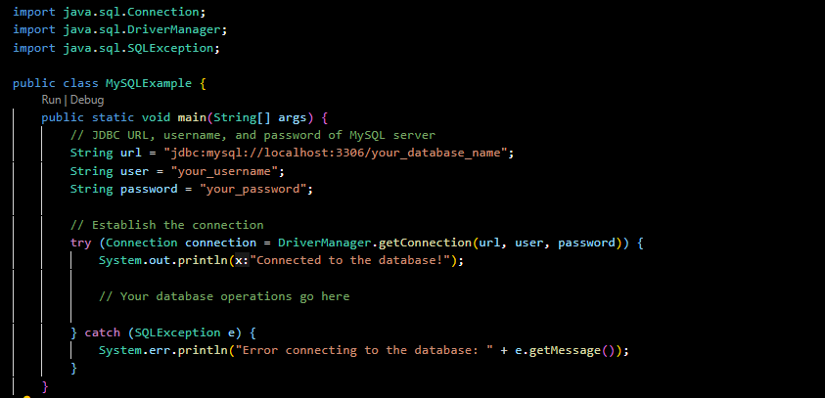
Connecting to database
In your Java code, create a connection to the MySQL database:

Slide 24
ASSIGNMENT
Explain briefly each type of JDBC Driver:
Type 1: JDBC-ODBC Bridge Driver
Type 2: JDBC-Native API Driver
Type 3: JDBC-Net Pure Java Driver
Type 4: Thin driver

